Slide 1
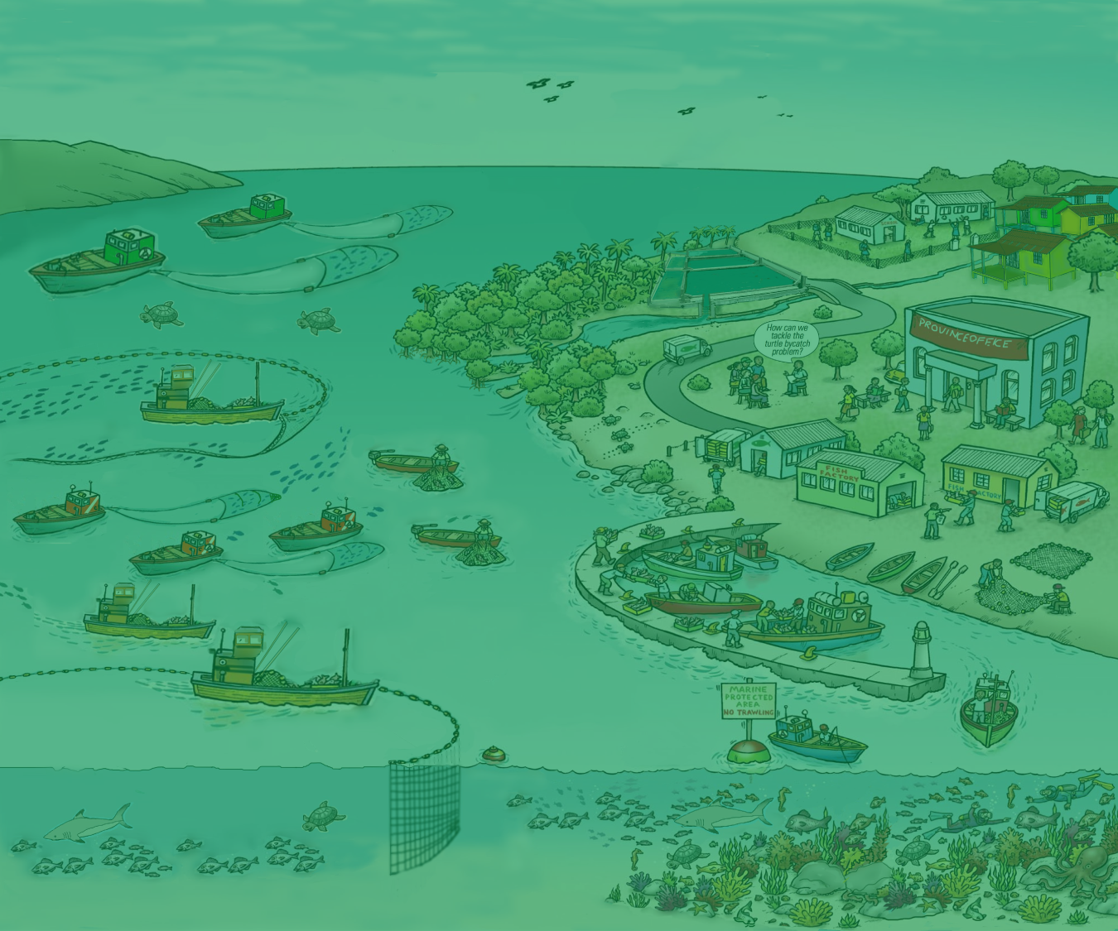
1. EAFM LEAD
Date • Place
Version 1

Slide 2
Opening Ceremony

Slide 3
Participant Introductions
3

Slide 4
OVERALL COURSE OBJECTIVE
Course for leaders, executives and decision-makers (LEADers)
Improved understanding of the Ecosystem Approach to Fisheries Management (EAFM) at different levels of government and across sectors.
Understand the need for developing capacity and taking steps towards the implementation of an EAFM
4
Notes:
These are the overall course objectives. Firstly participants will understand what EAFM is and secondly, be able apply it through developing and implementing an EAFM plan. This course focuses on capture fisheries but all the principles and activities can also apply to aquaculture.

Slide 5
What’s in it for you
and your agency?
helps link existing approaches through a logical and comprehensive framework
focuses on the real issues and their causes
increases trade opportunities and demand for fisheries products
reduces conflicts and political tensions
helps staff become more effective in natural resource management
helps leverage funding and leads to better allocation of existing funds
results in sharing of responsibilities and human resources with other agencies
5
Notes:
Self explanatory

Slide 6
09.00 | I. Opening and introductions | 60 mins
10.00 | II. Threats, issues and vision for the future | 30 mins
10.30 | PHOTO & TEA/COFFEE BREAK
11.00 | III. Overview of EAFM. Why EAFM? What is EAFM? | 45 mins
11.45 | IV. National roles, responsibilities and existing frameworks | 30 mins
12.15 | LUNCH BREAK
13.15 | Va. EAFM Planning process and importance of EAFM Plans: Plans and linkages | 30 mins
13.45 | Vb. EAFM Planning process and importance of EAFM Plans: EAFM planning process | 30 mins
14.15 | VI. EAFM institutional and management structures | 45 mins
15.00 | TEA/COFFEE BREAK
15.30 | VII. Developing capacity for EAFM | 30 mins
16.00 | VIII. Next steps and action plan | 45 mins
16.45 | CLOSING | 15 mins
6
Notes:
Refer participants to hard copy (Introduction section in handbook) and run through the day briefly, sharing a bit of what they will do ,including presentations, activities with plenty of time for discussions.

